Slide 1
Problem solving with theoretical probability
Probability: theoretical probabilities

Slide 2
How our teaching resources are designed for the classroom

Slide 3
I can use my knowledge of probability to solve problems.

Slide 4
A sample space is all the possible outcomes of a trial. A sample space diagram is a systematic way of producing a sample space.
Tree diagrams are a representation used to model statistical/probability questions. Branches represent different possible events or outcomes.
An outcome table is a table that shows all the possible outcomes.

Slide 5

Problem solving with theoretical probability
Using probability to inform decisions
Number of trials required to observe a difference

Slide 6

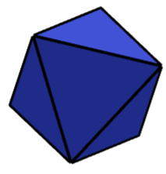
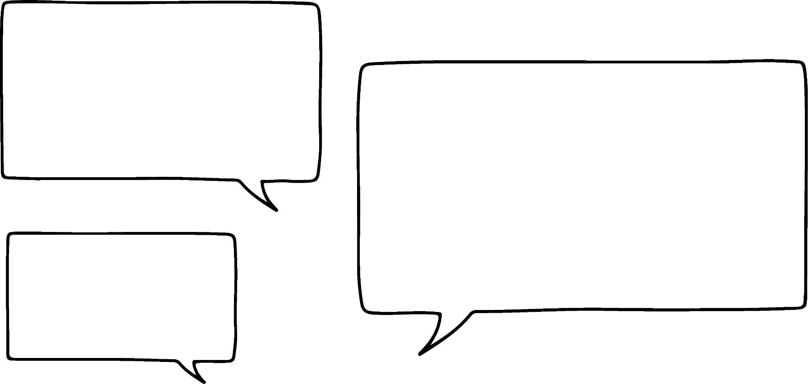



Using probability to inform decisions
Andeep and Laura are playing a game that involves choosing two dice, rolling them and summing their numbers.
Two of the dice are cubes containing numbers 1 to 6
Two of the dice are octahedrons containing numbers 1 to 8
There will be more ways to roll a total of 8 if you use the octahedron dice.
But there will also be more ways to roll other numbers too.
I want my two dice to sum to 8.

Slide 7

Using probability to inform decisions
Andeep and Laura are playing a game that involves choosing two dice, rolling them and summing their numbers.
Two of the dice are cubes containing numbers 1 to 6.
Two of the dice are octahedrons containing numbers 1 to 8.
I want my two dice to sum to 8.
I wonder which representation of the outcomes would be best suited to model this problem?
Which combination of two dice should Andeep choose?

Slide 8
Using probability to inform decisions
The outcomes for each pair of dice can be represented in a two-way outcome table.
 | 1 | 2 | 3 | 4 | 5 | 6 | 7 | 8
1
2
3
4
5
6
7
8

Slide 9

Using probability to inform decisions
The outcomes for each pair of dice can be represented in a two-way outcome table.
 | 1 | 2 | 3 | 4 | 5 | 6 | 7 | 8
1 | 2 | 3 | 4 | 5 | 6 | 7 | 8 | 9
2 | 3 | 4 | 5 | 6 | 7 | 8 | 9 | 10
3 | 4 | 5 | 6 | 7 | 8 | 9 | 10 | 11
4 | 5 | 6 | 7 | 8 | 9 | 10 | 11 | 12
5 | 6 | 7 | 8 | 9 | 10 | 11 | 12 | 13
6 | 7 | 8 | 9 | 10 | 11 | 12 | 13 | 14
7 | 8 | 9 | 10 | 11 | 12 | 13 | 14 | 15
8 | 9 | 10 | 11 | 12 | 13 | 14 | 15 | 16
P(8) =

Slide 10

Using probability to inform decisions
The outcomes for each pair of dice can be represented in a two-way outcome table.
 | 1 | 2 | 3 | 4 | 5 | 6 | 7 | 8
1 | 2 | 3 | 4 | 5 | 6 | 7 | 8 | 9
2 | 3 | 4 | 5 | 6 | 7 | 8 | 9 | 10
3 | 4 | 5 | 6 | 7 | 8 | 9 | 10 | 11
4 | 5 | 6 | 7 | 8 | 9 | 10 | 11 | 12
5 | 6 | 7 | 8 | 9 | 10 | 11 | 12 | 13
6 | 7 | 8 | 9 | 10 | 11 | 12 | 13 | 14
P(8) =

Slide 11

Using probability to inform decisions
The outcomes for each pair of dice can be represented in a two-way outcome table.
 | 1 | 2 | 3 | 4 | 5 | 6
1 | 2 | 3 | 4 | 5 | 6 | 7
2 | 3 | 4 | 5 | 6 | 7 | 8
3 | 4 | 5 | 6 | 7 | 8 | 9
4 | 5 | 6 | 7 | 8 | 9 | 10
5 | 6 | 7 | 8 | 9 | 10 | 11
6 | 7 | 8 | 9 | 10 | 11 | 12
P(8) =

Slide 12
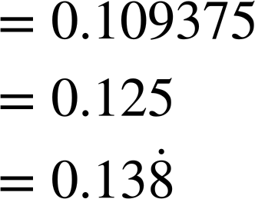

Using probability to inform decisions
The three probabilities could be compared to find the pair of dice which give the best chance of rolling a total of 8
P(8) =
It would be easier to compare the probabilities if I converted them all into decimals.
P(8) =
Using two cube dice would give the best probability of rolling a total of 8
P(8) =

Slide 13
Using probability to inform decisions
The three probabilities could be compared to find the pair of dice which give the best chance of rolling a total of 8.
P(8) =
P(8) =
You didn’t have to draw three separate tables to solve this.
It could have been solved by just drawing a single table.
P(8) =

Slide 14

Using probability to inform decisions
 | 1 | 2 | 3 | 4 | 5 | 6 | 7 | 8
1 | 2 | 3 | 4 | 5 | 6 | 7 | 8 | 9
2 | 3 | 4 | 5 | 6 | 7 | 8 | 9 | 10
3 | 4 | 5 | 6 | 7 | 8 | 9 | 10 | 11
4 | 5 | 6 | 7 | 8 | 9 | 10 | 11 | 12
5 | 6 | 7 | 8 | 9 | 10 | 11 | 12 | 13
6 | 7 | 8 | 9 | 10 | 11 | 12 | 13 | 14
7 | 8 | 9 | 10 | 11 | 12 | 13 | 14 | 15
8 | 9 | 10 | 11 | 12 | 13 | 14 | 15 | 16
You could start by drawing the biggest table that is required and then ignore the parts you don’t need later on.
P(8) =
P(8) =
P(8) =

Slide 15
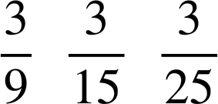
Using probability to inform decisions
Each spinner is spun and their outcomes are added together.
The two-way outcome table shows the sample space.
 | 1 | 2 | 3
1 | 2 | 3 | 4
2 | 3 | 4 | 5
3 | 4 | 5 | 6
1
3
1
3
2
2
What is the probability of getting a total of 4?

Slide 16


Using probability to inform decisions
Which combination of spinners is represented by the highlighted part part of the sample space?
1
3
1
3
 | 1 | 2 | 3 | 4 | 5
1 | 2 | 3 | 4 | 5 | 6
2 | 3 | 4 | 5 | 6 | 7
3 | 4 | 5 | 6 | 7 | 8
4 | 5 | 6 | 7 | 8 | 9
5 | 6 | 7 | 8 | 9 | 10
a
2
2
1
2
1
3
b
5
3
2
4
1
2
1
2
c
5
3
5
3
4
4

Slide 17
Using probability to inform decisions
Which combination of spinners gives the best probability of getting a total of 4?
1
3
1
3
 | 1 | 2 | 3 | 4 | 5
1 | 2 | 3 | 4 | 5 | 6
2 | 3 | 4 | 5 | 6 | 7
3 | 4 | 5 | 6 | 7 | 8
4 | 5 | 6 | 7 | 8 | 9
5 | 6 | 7 | 8 | 9 | 10
a
2
2
1
2
1
3
b
5
3
2
4
1
2
1
2
c
5
3
5
3
4
4

Slide 18
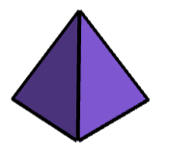
Using probability to inform decisions
1) Andeep is playing a game that involves choosing two dice, rolling them and summing their numbers.
Two of the dice are cubes containing numbers 1 to 6
Two of the dice are tetrahedrons containing numbers 1 to 4
a) Which combination of dice give the greatest probability of rolling a total of 8?
b) Which combination of dice give the greatest probability of rolling a total of 6?
c) Which combination of dice give the greatest probability of rolling a total of 7?
d) Write a summary that advises a player how to decide which pair of dice gives them the greatest probability of rolling the total they want.

Slide 19


Using probability to inform decisions
1) Andeep is playing a game that involves choosing two dice, rolling them and summing their numbers.
Two of the dice are cubes containing numbers 1 to 6
 | 1 | 2 | 3 | 4 | 5 | 6
1 | 2 | 3 | 4 | 5 | 6 | 7
2 | 3 | 4 | 5 | 6 | 7 | 8
3 | 4 | 5 | 6 | 7 | 8 | 9
4 | 5 | 6 | 7 | 8 | 9 | 10
5 | 6 | 7 | 8 | 9 | 10 | 11
6 | 7 | 8 | 9 | 10 | 11 | 12
Two of the dice are tetrahedrons containing numbers 1 to 4
The sample space could be represented with a two-way outcome table.

Slide 20
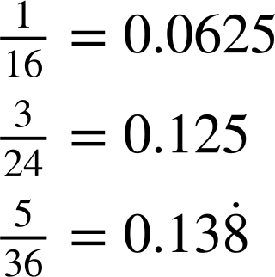
Using probability to inform decisions
a) Which combination of dice give the greatest probability of rolling a total of 8?
2 tetrahedrons: P(8) = 1 of each dice: P(8) = 2 cubes: P(8) =
 | 1 | 2 | 3 | 4 | 5 | 6
1 | 2 | 3 | 4 | 5 | 6 | 7
2 | 3 | 4 | 5 | 6 | 7 | 8
3 | 4 | 5 | 6 | 7 | 8 | 9
4 | 5 | 6 | 7 | 8 | 9 | 10
5 | 6 | 7 | 8 | 9 | 10 | 11
6 | 7 | 8 | 9 | 10 | 11 | 12
2 cube dice

Slide 21
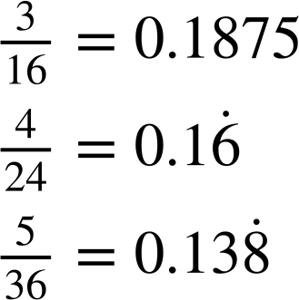
Using probability to inform decisions
b) Which combination of dice give the greatest probability of rolling a total of 6?
2 tetrahedrons: P(6) = 1 of each dice: P(6) = 2 cubes: P(6) =
 | 1 | 2 | 3 | 4 | 5 | 6
1 | 2 | 3 | 4 | 5 | 6 | 7
2 | 3 | 4 | 5 | 6 | 7 | 8
3 | 4 | 5 | 6 | 7 | 8 | 9
4 | 5 | 6 | 7 | 8 | 9 | 10
5 | 6 | 7 | 8 | 9 | 10 | 11
6 | 7 | 8 | 9 | 10 | 11 | 12
2 tetrahedron dice

Slide 22
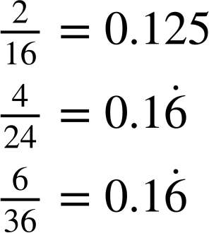
Using probability to inform decisions
c) Which combination of dice give the greatest probability of rolling a total of 7?
2 tetrahedrons: P(7) = 1 of each dice: P(7) = 2 cubes: P(7) =
 | 1 | 2 | 3 | 4 | 5 | 6
1 | 2 | 3 | 4 | 5 | 6 | 7
2 | 3 | 4 | 5 | 6 | 7 | 8
3 | 4 | 5 | 6 | 7 | 8 | 9
4 | 5 | 6 | 7 | 8 | 9 | 10
5 | 6 | 7 | 8 | 9 | 10 | 11
6 | 7 | 8 | 9 | 10 | 11 | 12
either 2 cube dice or 1 of each dice

Slide 23
Using probability to inform decisions
d) Write a summary that advises a player how to decide which pair of dice gives them the greatest probability of rolling the total they want.
 | 1 | 2 | 3 | 4 | 5 | 6
1 | 2 | 3 | 4 | 5 | 6 | 7
2 | 3 | 4 | 5 | 6 | 7 | 8
3 | 4 | 5 | 6 | 7 | 8 | 9
4 | 5 | 6 | 7 | 8 | 9 | 10
5 | 6 | 7 | 8 | 9 | 10 | 11
6 | 7 | 8 | 9 | 10 | 11 | 12
Use two tetrahedral dice when you want to roll a total of 6 or less.
Use two cube dice when you want to roll a total of 7 or more.
Alternatively, you could use one of each dice if you want to roll a total of 7.

Slide 24
Problem solving with theoretical probability
Using probability to inform decisions
Number of trials required to observe a difference

Slide 25


Number of trials required to observe a difference
Lucas and Sofia have designed an app containing a chance-based game.
Players have a 1% probability of finding a rare gem each turn. This means a player could expect to find approximately 1 gem in every 100 turns.
Lucas changes the game to make it easier for players to find a gem.
I have increased the probability of finding a gem by 50%.
Oh no! That makes it far too easy!
Players will now get approximately 51 gems for every 100 turns.
Is Sofia correct?

Slide 26

Number of trials required to observe a difference
The probability of finding a gem in the original version was 1%.
Lucas has increased the probability by 50%.
1% × 1.5 = 1.5%
original probability
50% increase
new probability
The probability of finding a gem in the new version of the game is 1.5%.
This calculation could also be performed with the probabilities expressed as their equivalent decimals.

Slide 27

Number of trials required to observe a difference
The probability of finding a gem in the original version was 0.01.
Lucas has increased the probability by 50%.
0.01 × 1.5 = 0.015
original probability
50% increase
new probability
The probability of finding a gem in the new version of the game is 0.015.
The increase isn’t as much as I thought.

Slide 28
Number of trials required to observe a difference
They consider what difference the increased probability will make to number of gems that players can expect with each version of the game.
They compare the number of gems that can be expected from 100 turns.
 | original version | new version | difference
probability of finding gem | 1% | 1.5% | 0.5%
expectation per 100 turns
That doesn’t make sense. You can’t find 1.5 gems.
1
1.5
0.5

Slide 29
Number of trials required to observe a difference
They compare the number of gems that can be expected from 1000 turns.
original expectation:
1% of 1000
= 0.01 × 1000
 | original version | new version | difference
probability of finding gem | 1% | 1.5% | 0.5%
expectation per 100 turns | 1 | 1.5 | 0.5
expectation per 1000 turns
= 10
new expectation:
1.5% of 1000
= 0.015 × 1000
= 15
10
15
5
difference:
15 − 10 = 5

Slide 30
Number of trials required to observe a difference
They compare the number of gems that can be expected from 1000 turns.
 | original version | new version | difference
probability of finding gem | 1% | 1.5% | 0.5%
expectation per 100 turns | 1 | 1.5 | 0.5
expectation per 1000 turns
When you said the probability had increased by 50%, it first sounded like players were going to find loads more gems.
10
15
5

Slide 31
Number of trials required to observe a difference
They compare the number of gems that can be expected from 1000 turns.
 | original version | new version | difference
probability of finding gem | 1% | 1.5% | 0.5%
expectation per 100 turns | 1 | 1.5 | 0.5
expectation per 1000 turns
But even after 1000 turns, players can only expect to find 5 extra gems with the new version of the game.
That’s not very many gems.
10
15
5

Slide 32
Number of trials required to observe a difference
They consider the number of turns required to expect a difference of 1 extra gem between the two versions of the game.
What is the value of x in the table?
 | original version | new version | difference
probability of finding gem | 1% | 1.5% | 0.5%
expectation per 100 turns | 1 | 1.5 | 0.5
original expectation:
1% of x = 0.01x
new expectation:
1.5% of x = 0.015x
difference:
0.015x − 0.01x = 1
expectation per x turns
0.01x
0.015x
1
0.005x = 1
x = 200

Slide 33
Number of trials required to observe a difference
They consider the number of turns required to expect a difference of 1 extra gem between the two versions of the game.
What is the value of x in the table?
That means we would only expect to observe a difference between the two versions of the game after a player has taken 200 turns.
 | original version | new version | difference
probability of finding gem | 1% | 1.5% | 0.5%
expectation per 100 turns | 1 | 1.5 | 0.5
difference:
0.015x − 0.01x = 1
expectation per x turns
0.01x
0.015x
1
0.005x = 1
x = 200

Slide 34
Number of trials required to observe a difference
The probability of finding a gem has increased by 40%, from the original game to the new game.
What is the probability of finding a gem in the new game?
a
5.4%
 | original game | new game
probability of finding gem | 5% | ?
b
7%
c
40%
0.05 × 1.4 = 0.07
d
45%

Slide 35
Number of trials required to observe a difference
d is the difference between the number of gems that can be expected after 100 turns with each game.
What is the value of d?
 | original game | new game | difference
probability of finding gem | 5% | 7%
expectation per 100 turns |  |  | d
7 − 5 = 2
2%
or
5
7
= 2
2% of 100 = 2

Slide 36
Number of trials required to observe a difference
x is the number of turns required to expect a difference of 1 gem between the two games.
What is the value of x?
 | original game | new game | difference
probability of finding gem | 5% | 7%
expectation per 100 turns | 5 | 7 | 2
expectation per x turns |  |  | 1
0.07x − 0.05x = 1
2%
0.02x = 1
x = 50
0.05x
0.07x

Slide 37
Number of trials required to observe a difference
1) Lucas creates two versions of the same video game: Version A and Version B. In Version A, the probability that a player finds a gem is 0.02 Players are 10% more likely to find a gem in Version B than in Version A.
 | Version A | Version B | difference
probability of finding gem | 0.02
expected gems per 100 turns
expected gems per 1000 turns
a) Complete the table.
b) How many turns would it take to expect a difference of 1 gem between the two versions of the game?

Slide 38
Number of trials required to observe a difference
2) Sofia creates a video game where players have a 0.5% probability of getting caught in a trap each turn. She creates a new version of the game where players are now 20% more likely to get caught in a trap each turn, compared to the original version of the game.
a) What is the probability of getting caught in a trap in the new version of the game?
b) How many turns would it take to expect a difference of 1 extra trap between the two versions of the game?

Slide 39
Number of trials required to observe a difference
1) Lucas creates two versions of the same video game: Version A and Version B. In Version A, the probability that a player finds a gem is 0.02 Players are 10% more likely to find a gem in Version B than in Version A.
 | Version A | Version B | difference
probability of finding gem | 0.02
expected gems per 100 turns
expected gems per 1000 turns
a) Complete the table.
0.022
0.002
0.02 × 1.1 = 0.022
0.022 − 0.02 = 0.002
2
2.2
0.2
0.02 × 1000 = 20
20
22
2
0.022 × 1000 = 22
22 − 20 = 2

Slide 40
Number of trials required to observe a difference
1) Lucas creates two versions of the same video game: Version A and Version B. In Version A, the probability that a player finds a gem is 0.02 Players are 10% more likely to find a gem in Version B than in Version A.
 | Version A | Version B | difference
probability of finding gem | 0.02
expected gems per 100 turns
expected gems per 1000 turns
expected gems per x turns |  |  | 1
b) How many turns would it take to expect a difference of 1 gem between the two versions of the game?
0.022
0.002
2
2.2
0.2
0.022x − 0.02x = 1
20
22
2
0.002x = 1
x = 500
0.02x
0.022x
500 turns

Slide 41
Number of trials required to observe a difference
1) Lucas creates two versions of the same video game: Version A and Version B. In Version A, the probability that a player finds a gem is 0.02 Players are 10% more likely to find a gem in Version B than in Version A.
 | Version A | Version B | difference
probability of finding gem | 0.02
expected gems per 100 turns
expected gems per 1000 turns
expected gems per x turns |  |  | 1
b) How many turns would it take to expect a difference of 1 gem between the two Versions of the game?
0.022
0.002
2
2.2
0.2
Alternatively, proportional reasoning could be used.
20
22
2
÷ 2
÷ 2
÷ 2
÷ 2
10
11
500 turns

Slide 42
Number of trials required to observe a difference
2) Sofia creates a video game where players have a 0.5% probability of getting caught in a trap each turn. She creates a new version of the game where players are now 20% more likely to get caught in a trap each turn, compared to the original version of the game.
a) What is the probability of getting caught in a trap in the new version of the game?
0.5% × 1.2 = 0.6%
b) How many turns would it take to expect a difference of 1 extra trap between the two versions of the game?
0.006x − 0.005x = 1
0.001x = 1
x = 1000
1000 turns

Slide 43
Problem solving with theoretical probability
Knowledge of probability can be applied to real world situations, such as games of chance.
Probabilities can be used to aid decision making.
Creating a sample space using a table or diagram may help you solve a problem involving probability.
Theoretical probabilities come from long-term behaviour and therefore may not be seen in the short-term.
A very large number of trials may be required in order to observe a difference between events with different probabilities.

Slide 44

© Oak National Academy 2024.
Produced in partnership with Mathematics in Education and Industry.
Licensed on the Open Government Licence v3.0, except where otherwise stated. See Oak terms and conditions.

